Slide 1

Design Choices

Slide 2
0. We Already Communicate in Graphs
Relational data management techniques require us to deviate from our natural language representation of the domain, i.e., these transformations introduce semantic dissonance between our conceptualization of the world and the database’s instantiation of that model. With graph databases, this gap shrinks considerably. Graph databases organize data around entities and their relationships, bringing the database representation closer to the way we understand the real world.
There are no natural representations of the world the way it "really is", just many purposeful selections, abstractions, and simplifications, some of which are more useful than others for satisfying a particular goal.

Slide 3
0. Domain modeling vs graph modeling
Domain modeling and graph modeling are closely aligned. In a graph database, the concepts and connections represented in a domain model can often be translated directly into nodes, labels, properties, and relationships.
Graph modeling is not simply about storing data as nodes and edges. It involves understanding the domain, representing its meaningful structure, and validating that structure against real application queries.
Ultimately, a well-designed graph model should accurately reflect the business domain while making the application's expected queries natural and efficient.

Slide 4
1. Understand and describe the domain.
In the early stages of analysis, the process is similar to relational data modeling. We use low-fidelity methods, such as whiteboard sketches, user stories, conceptual graph, semantic network to describe the domain and agree on its main concepts.
1. Describe the client or end-user goals that motivate our model.
    The questions we need to ask about the data help identify entities and relationships.
2. Write agile user stories provide a concise means for expressing an outside-in, user-centered view of an application’s needs, and the questions that arise trying to satisfy this need. Use a conceptual graph to represent the user stories. We should start with atomic concepts: simple, well-defined concepts that can be understood independently. This helps reduce unnecessary dependencies between concepts and avoid common design pitfalls. One important distinction: atomic concepts are a useful modeling principle, but they do not necessarily mean that every concept must become a separate node. The decision depends on the domain's semantics and the queries the application needs to support. Likewise, properties can belong to both nodes and relationships in a property graph.
3. Leverage the user story to build the first conceptual graph.
4. Rewrite the goals as functional competency questions (FCQ) to ask of our domain in term of the user stories.

Slide 5
1. Understand and describe the domain.
  4. Rewrite the goals as functional competency questions (FCQ) to ask of our domain in term of the user stories.
  A CQ is functional if, without its answer, the knowledge base cannot provide a meaningful, accurate, and relevant representation of the intended domain.
    Purpose: does the CQ directly relate to the primary purpose and scope of the domain?
    Relevance: does the CQ address a genuine information need, user requirement, or business activity within the domain?
    Coverage: does the CQ address an essential concept, relationship, process, or business function necessary to represent the domain?
    Answerability: does the knowledge base contain sufficient information to provide a meaningful and sufficiently accurate answer?
    Necessity: if the question or its corresponding knowledge were removed, would the knowledge base lose an essential part of its intended meaning, representation, or functionality?
  Add new CQs to validate aspects of the model not covered by the functional competency questions (non-functional CQs). nFCQs should saturate the user stories. These includes:
    Supplementary Competency Questions (sCQs): to cover aspects not addressed by functional CQs, filling gaps or adding missing coverage.
    Quality Competency Questions (qCQs): they focus on quality aspects.
    Coverage Competency Questions (cCQs): ensure complete user-story coverage.
    Complementary Competency Questions (cCQs) – to complement functional CQs, supporting and completing existing coverage.

Slide 6
1. Understand and describe the domain.
  5. Write the competency questions as graph pattern using path expressions similar to the ones we used to model the domain. The goal is to refine the conceptual graph and, possibly, the user stories. This is the preliminary validation step.
  6. Identify the entities and the relationships that appear in these questions. Use a semantic network to represent the obtained model.
  7. Re-apply the step 5 to the semantic network. This is the second validation step.
  In the next step we build the LPG model

Slide 7
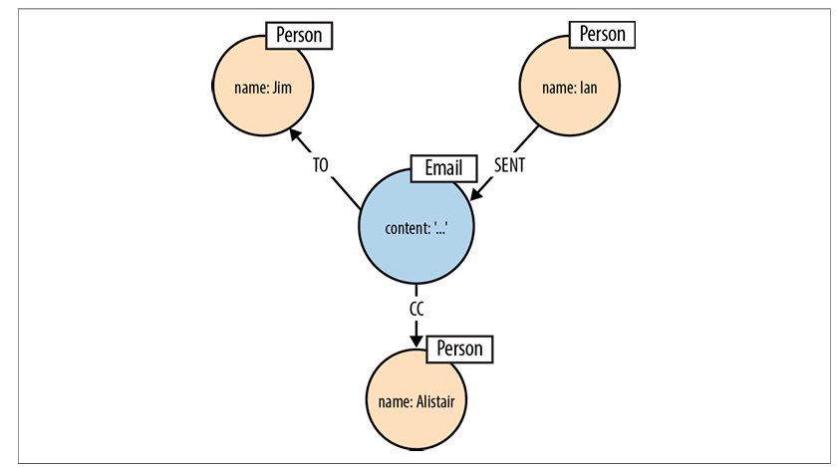
2. Enrich and refine the
domain model
We refine the model to accurately represent the parts of the domain that are relevant to our application's goals. By examining the language we use to describe our domain, we can very quickly identify the core elements in our graph (generally):
  Common nouns become labels.
  Verbs that take an object become relationship names (transitive vs intransitive vs purpose clause).
  A proper noun refers to an instance of a thing, which we model as a node, using one or more properties to capture that entity's attributes.
Domain entities aren't always immediately visible in speech, so we must think carefully about the nouns. We're actually dealing with, e.g., "emailing" vs "sending email".

Slide 8
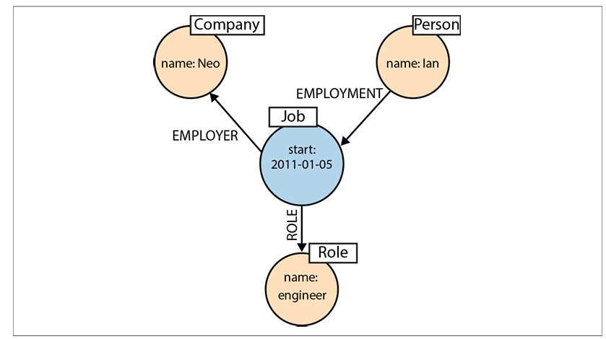
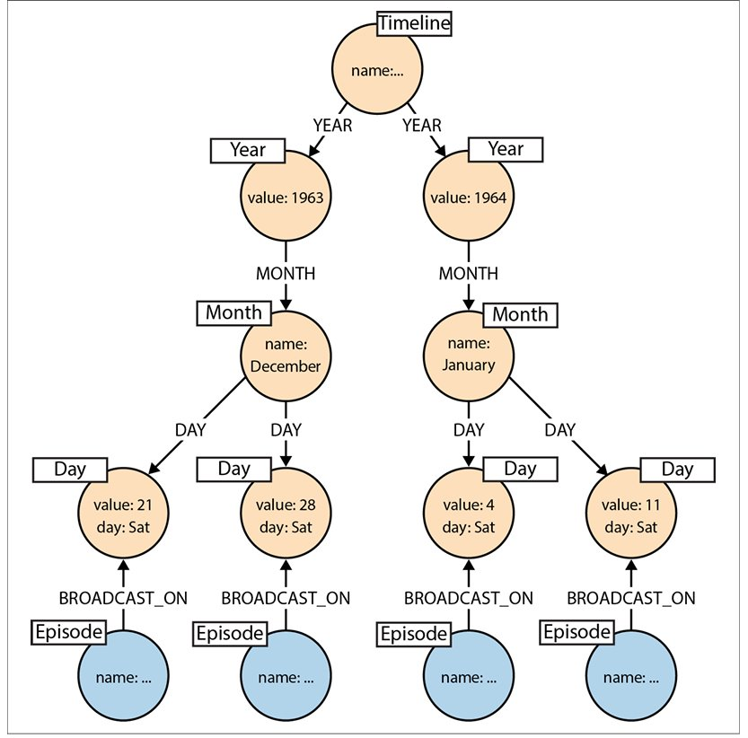
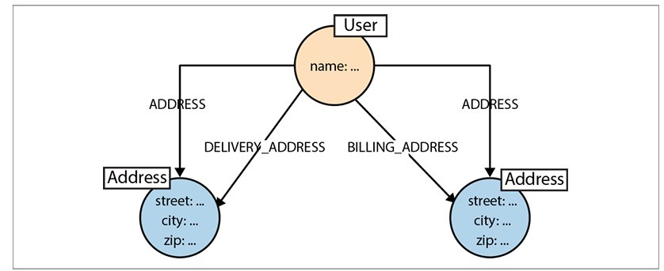
2. Enrich and refine the domain model
For each element, we identify labels, properties, and relationships, generally speaking, as follows.
  Node: represents self-existing elements.
    When two or more domain entities interact for a period of time, a fact emerges. We represent a fact as a separate node with connections to each of the entities engaged in that fact.
    Value types are things that do not have an identity, and whose equivalence is based solely on their values. However, complex value types are value types with more than one field or property. Such value types may be usefully represented as separate nodes.
    If we need to find all the events that have occurred over a specific period, we can build a timeline tree of nodes.

Slide 9
2. Enrich and refine the domain model
    Labels: Represent the roles or categories that nodes belong to in the domain. Labels are first-class elements of the property graph model. They help classify nodes and can support the association of metadata with nodes belonging to specific categories.​ Pay attention to
      hyponymy/hyperonym, (is-a-type-of),
      meronymy (part-of),
      synonymy (same-of), and
      association (related-to).
    Properties: Represent the attributes that describe nodes or relationships. They store descriptive information as key-value pairs.​
    Relationships: Represent the connections between nodes. Their names and directions establish semantic context by explaining how entities are connected. Relationships can connect different domains or help distinguish and organize areas of the graph.​
      When designing relationships we should be mindful of the trade-offs between using fine-grained relationship names versus generic relationships qualified with properties. ​
      Remember: LPGs do not support formal semantics (natively).

Slide 10
3. Validate the model against realistic queries​
  We formalize the CQs in the target query language.
  We test whether the model can support the queries that users are likely to perform. This requires understanding end users' goals and the application's use cases.​​
  We use a subset of real data to perform query. Synthetic data can be used as well in certain context.
  Although graphs can accommodate evolving structures, some early design decisions can create problems later. Reviewing the domain and graph models before implementation helps us identify final potential issues and avoid costly redesigns.​​
  The goal is to adopt a design for queryability mindset: design the graph around the questions the application needs to answer. Future changes to the graph should ideally reflect changes in business requirements rather than compensate for poor initial design decisions.​​
​

Slide 11
Final Considerations
A graph model can be expressive and flexible, yet still be poorly designed for its intended purpose.
The flexibility to represent many kinds of connections does not automatically mean that the resulting model is correct, efficient, or suitable for the application's needs. Design mistakes are behind the corner:
  Choosing the wrong relationships between entities.
    Independent relationships between nodes do not necessarily imply an association between their respective target nodes
  Representing information as properties when it should be modeled as separate nodes, or vice versa.
    E.g., "email_to".
  Overcomplicating the graph structure.
    E.g., timeline tree.
  Failing to consider the queries the application needs to answer.

Slide 12
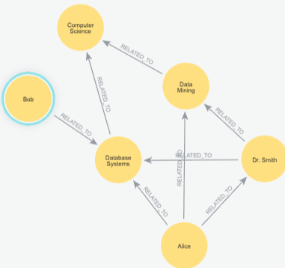
Final Considerations
Bad design choices vs
good design choices

Slide 13
Final Considerations
Bad design choices vs
good design choices
Generic labels. Cannot distinguish entity types easily.
Generic RELATED_TO relationship, meaning is unclear.
Student name as identifier in NUNA.
Missing enrollment entity, enrollment details cannot be represented properly.
Missing academic year, cannot distinguish enrollments across years.
Missing constraints, duplicate entities can be created.
Missing relationship direction semantics, makes the model harder to understand.
Mixing professor and student relationships, different academic roles are not clearly represented.

Slide 14
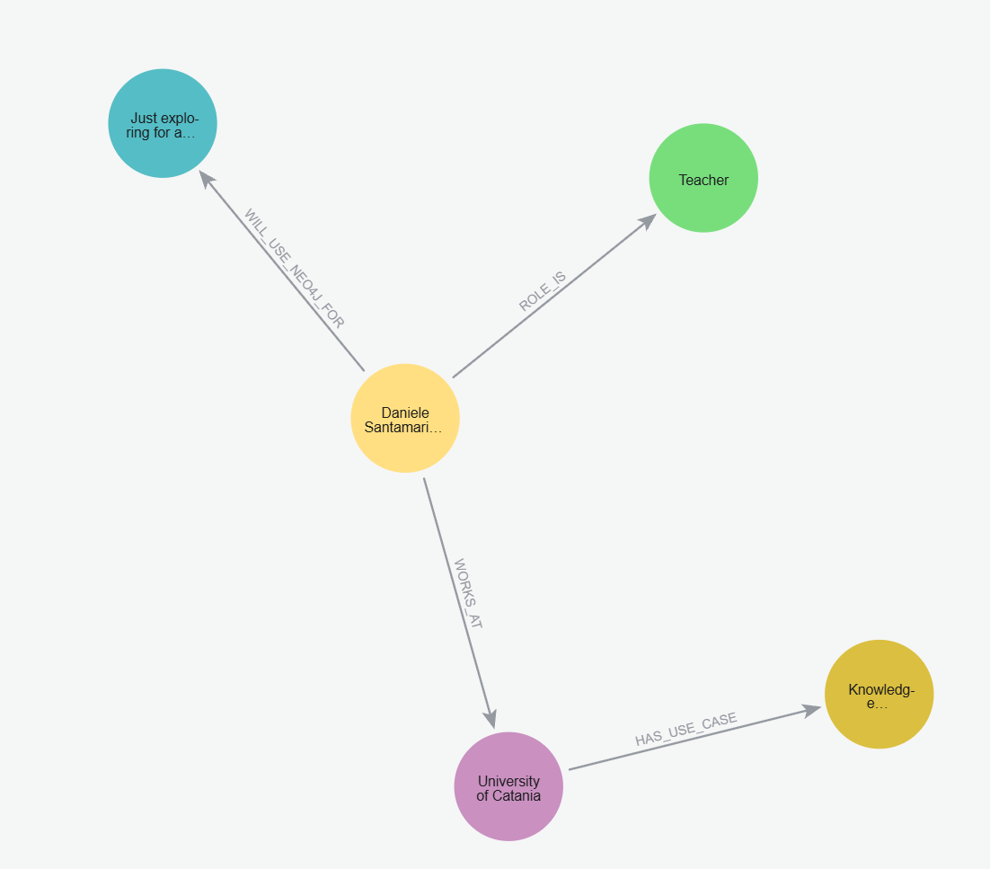
Final Considerations
Bad design choices vs
good design choices

Slide 15
Final Considerations
​
Bad design choices vs
good design choices
A person may hold two or more jobs at different locations during the same period.
A person may perform two or more roles at the same location during the same period.
A person may use Neo4j for two or more purposes within the same job.
A person may use Neo4j for two or more purposes across different jobs.

Slide 16
Final Considerations
Like any database, a graph database supports an application whose requirements may change over time. New business requirements can introduce new entities, relationships, or attributes.
A migration is a change to the database structure or data to accommodate these evolving requirements.
We cannot completely avoid migrations, but graph databases often make structural changes easier because we can extend the graph by adding nodes and relationships.
The important distinction is between extending the graph and changing existing structures.
Adding a new relationship type usually does not affect queries that do not use it. However, even additive changes can affect queries that make assumptions about the graph's structure, so compatibility should not be taken for granted.

Slide 17
Final Considerations
​
Type of change | Example | Risk
Add new node types or relationship types | Add a SUPPLIER node and a SUPPLIES relationship. | Generally low; existing queries remain unaffected if their assumptions are unchanged.
Change existing relationship structures | Change how CUSTOMER nodes connect to ORDER nodes. | May affect queries that depend on the previous structure.
Change existing node properties | Rename or remove a property or change how it is represented. | May break queries and application code that depend on that property.

Slide 18
Final Consideration
A Knowledge Graph is not just a representation of existing data. It is a model of the domain, and its quality determines which questions can be answered

